Slide 1
Basic Probability

Slide 2
What is Probability
Probability is a numerical measure of the likelihood that an event will occur. It quantifies as a number between 0 and 1.

Slide 3
Applications
Agro-industry - What is the likelihood of good monsoon?
Finance – Will the interest rates increase?
Marketing – What will be demand for the product next year?
Production – What is chance of finding 5 defective parts in the batch?
HR – How many employees will leave the company?

Slide 4
Definition
Experiment: A process that produces well defined outcomes.
Eg. Tossing a Coin is an experiment or tossing 4 coins is an experiment
Outcome: Each one of many results that an experiment produces. We can not predict the outcome without actually conducting the experiment.
Eg. Toss a coin, possible outcomes are head or tail , rolling a dice – 1,2,3,4,5,6
Event : A single result of an experiment
Eg. Getting Tail when tossing a coing or getting no. 5 while rolling a dies
Trial: A single repetition of experiment in which only one outcome is possible.
Eg. Tossing 2 coins, each coin in an experiment is a trial
Sample Space: Set of all experimental outcomes. An outcome is also called sample point or element of sample space.
Eg. Toss one coing, and its sample space is {H,T} , Toss 2 coins, - all possible outcomes are {HH,HT,TH,TT}

Slide 5
Example 1
Jerry wants to see how many times a doubles comes up while rolling 2 dices
Solution :
Experiment : Rolling a dice
Outcome : {1,1} {1,2} {1,3} … {6,4} {6,5} { 6,6} # 6*6 = 36 outcomes
Event : Jerry is looking for is double :
{1,1} {2,2} {3,3} {4,4} {5,5} {6,6}
Trail : Dice is rolled only once, so trail is 1
Sample space : all possible outcomes, so its 36

Slide 6
How to compute Probability
The probability that the experiment results in a successful outcome (S) is:
P(S) = ( Number of successful outcomes ) / ( Total number of equally likely outcomes ) = r / n

Slide 7
Example 1
A coin is tossed three times. What is the probability that it lands on heads exactly one time?
(A) 0.125 (B) 0.250 (C) 0.333 (D) 0.375 (E) 0.500

Slide 8
Example 1 : solution
A coin is tossed three times. What is the probability that it lands on heads exactly one time?
Solution :
Combination : 8: HHH, HHT, HTH, THH, HTT, THT, TTH, and TTT
Exactly one head :3: TTH, THT , HTT
probability that three flips of a coin will produce exactly one head is 3
=3/8
=0.375.

Slide 9
Assigning Probabilities
Basic requirements for assigning probabilities
The probability assigned to each outcome must be between 0 and 1 inclusive. Mathematically if E_{i} is the i^{th} experimental outcome and P(E_{i}) then
0 ≤ P(E_{i}) ≤ 1 for all i.
The sum of all probabilities for all the experimental outcomes must equal 1. If an experiment has n possible outcomes then
P(E₁) + P(E₂) + .... + P(E_{n}) = 1

Slide 10
Definition and Notation
Mutually Exclusive or Disjoint : when 2 events cannot occur at the same time
Conditional Probability : The probability that Event A occurs, given that Event B has occurred . The conditional probability of Event A, given Event B, is denoted by the symbol P(A|B)
Complement : The complement of an event is the event not occurring. The probability that Event A will not occur is denoted by P(A').
Intersection : The probability that Events A and B both occur is the probability of the intersection of A and B. The probability of the intersection of Events A and B is denoted by P(A ∩ B). If Events A and B are mutually exclusive, P(A ∩ B) = 0
Union : The probability that Events A or B occur is the probability of the union of A and B. The probability of the union of Events A and B is denoted by P(A ∪ B) .
Dependent Event : If the occurrence of Event A changes the probability of Event B, then Events A and B are dependent
Independent Event : if the occurrence of Event A does not change the probability of Event B, then Events A and B are independent
Joint Probability : The probability of event A and event B occurring. It is the probability of the intersection of two or more events. The probability of the intersection of A and B may be written p(A ∩ B).
Joint probability is independent event

Slide 11
Counting Rules
Permutations : Permutations are for lists (order matters)
Eg : Locker key is a best example, for which order matters
Combinations : combinations are for groups (order doesn’t matter)
Eg. Possible ways to group 3 people in a team of 2

Slide 12


Permutation Example 1
Total people : A B C D E F G H
How many ways can we award a 1st, 2nd and 3rd place prize among eight contestants? (Gold / Silver / Bronze) ?
Solution :
If we have n items total and want to pick k in a certain order, we get:
= 6720

Slide 13
Permutation Example 2
Picking a President, VP and Waterboy from a group of 10
Solution :
P(10,3)
= 10!/7!
= 10 !· 9! · 8!
= 604,800

Slide 14

Combination Example1
Total people : A B C D E F G H
How many ways can I give 3 tin cans to 8 people?
Solution :
Find all the ways to pick k people from n, and divide by the k! variants
= 336/6
= 56

Slide 15
Combination Example 2
Picking a team of 3 people from a group of 10
Solution :
C(10,3)
= 10!/(7! · 3!)
= 10 · 9 · 8 / (3 · 2 · 1)
= 120

Slide 16
Rule of Subtraction
The probability that event A will occur is equal to 1 minus the probability that event A will not occur.
P(A) = 1 - P(A')

Slide 17
Rule of Subtraction - Example
Suppose, for example, the probability that Bill will graduate from college is 0.80. What is the probability that Bill will not graduate from college?
Solution :
Based on the rule of subtraction
probability that Bill will not graduate is 1.00 - 0.80 or 0.20

Slide 18
Addition law of Probability
The addition law provides a way for computing probability of occurrence that either event A or event B or both will occur.
P(A ∪ B) = P(A) + P(B) – P(A ∩ B)
Or
P(A ∪ B) = P(A) + P(B) - P(A)P( B | A )

Slide 19
Probability Example1
An urn contains 6 red marbles and 4 black marbles. Two marbles are drawn without replacement from the urn. What is the probability that both of the marbles are black?

Slide 20
Probability Example1
An urn contains 6 red marbles and 4 black marbles. Two marbles are drawn without replacement from the urn. What is the probability that both of the marbles are black?
Solution :
Let A = the event that the first marble is black; and let B = the event that the second marble is black. We know the following:
In the beginning, there are 10 marbles in the urn, 4 of which are black. Therefore, P(A) = 4/10.
After the first selection, there are 9 marbles in the urn, 3 of which are black. Therefore, P(B|A) = 3/9.
Therefore, based on the rule of multiplication:
P(A ∩ B) = P(A) P(B|A) P(A ∩ B) = (4/10) * (3/9) = 12/90 = 2/15 = 0.133

Slide 21
Probability Example 2
An urn contains 6 red marbles and 4 black marbles. Two marbles are drawn with replacement from the urn. What is the probability that both of the marbles are black?

Slide 22
Probability Example2
An urn contains 6 red marbles and 4 black marbles. Two marbles are drawn with replacement from the urn. What is the probability that both of the marbles are black?
Solution :
Let A = the event that the first marble is black; and let B = the event that the second marble is black. We know the following:
In the beginning, there are 10 marbles in the urn, 4 of which are black. Therefore, P(A) = 4/10.
After the first selection, there are 9 marbles in the urn, 3 of which are black. Therefore, P(B|A) = 4/10.
Therefore, based on the rule of multiplication:
P(A ∩ B) = P(A) P(B|A) P(A ∩ B) = (4/10) * (4/10) = 16/100 = .16

Slide 23
Probability Example3
A student goes to the library. The probability that she checks out (a) a work of fiction is 0.40, (b) a work of non-fiction is 0.30, and (c) both fiction and non-fiction is 0.20. What is the probability that the student checks out a work of fiction, non-fiction, or both?

Slide 24
Probability Example – solution3
A student goes to the library. The probability that she checks out (a) a work of fiction is 0.40, (b) a work of non-fiction is 0.30, and (c) both fiction and non-fiction is 0.20. What is the probability that the student checks out a work of fiction, non-fiction, or both?
Solution:
Let F = the event that the student checks out fiction; and let N = the event that the student checks out non-fiction. Then, based on the rule of addition:
P(F ∪ N) = P(F) + P(N) - P(F ∩ N) P(F ∪ N) = 0.40 + 0.30 - 0.20 = 0.50

Slide 25
Probability Example 4
In a deck of cards which has 52 cards and what is the probability to draw 2 kings from the deck without replacement.

Slide 26
Probability Example 4
Deck of cards has 52 cards and we draw 2 kings from the deck.
P(A) – 1st event =4/52
P(B) – 2nd event = 3/51
P(A and B) = P(A) x P(B|A) = (4/52) x (3/51) = 12/2652 = 1/221
chance of getting 2 Kings is 1 in 221, or about 0.0045%

Slide 27
Joint Probability
The probability of event A and event B occurring. It is the probability of the intersection of two or more events.
The probability of the intersection of A and B may be written p(A ∩ B).
Joint probability is independent event

Slide 28
Joint Probability Example
What is the probability to get 4 which has colour red in it ?
the probability that a card is a four and red
= 2/52 = 1/26
# P(4) * P(red)
#P(4) = 4/52
#P(red) = 26/52
=(4/52) * (26/52) = 1/26 = .038 or 3.8%

Slide 29
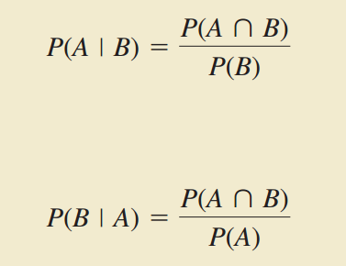
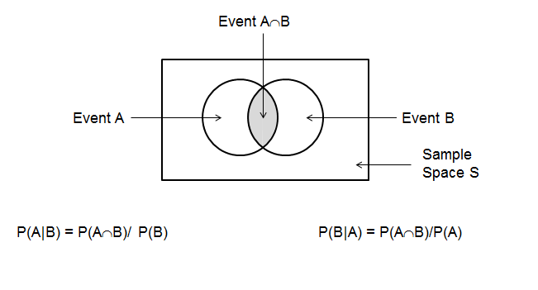
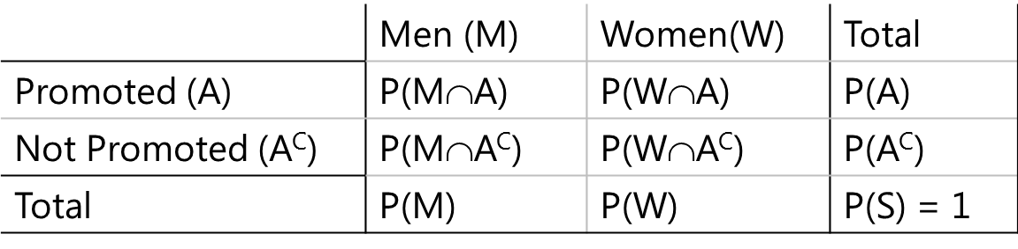
Conditional Probability
The probability of an event influenced by whether a related event has already occurred is called a conditional probability.
The probability that Event A occurs, given that Event B has occurred, is called a conditional probability. The conditional probability of Event B given Event A, is denoted by the symbol P(B|A), reads “the probability of B given A”
Joint Probabilities
Marginal Probabilities

Slide 30
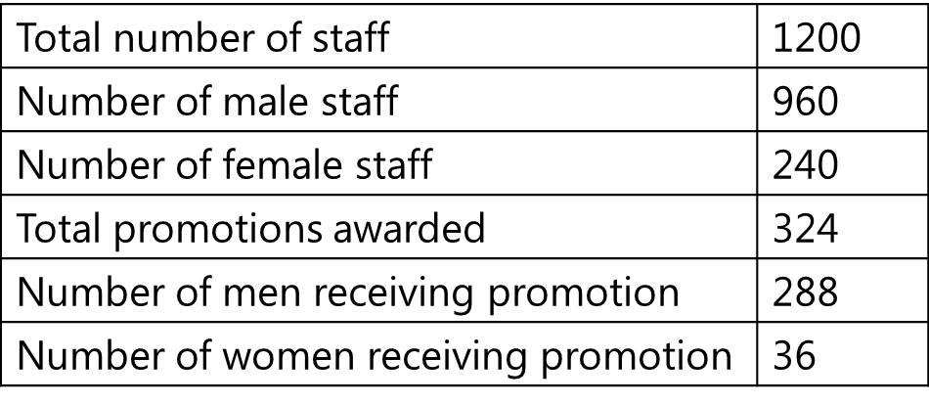
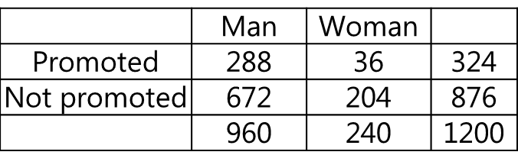
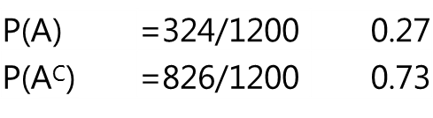
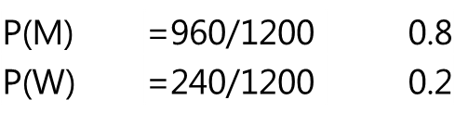
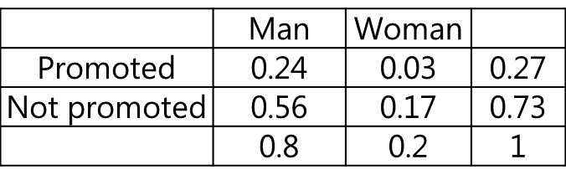
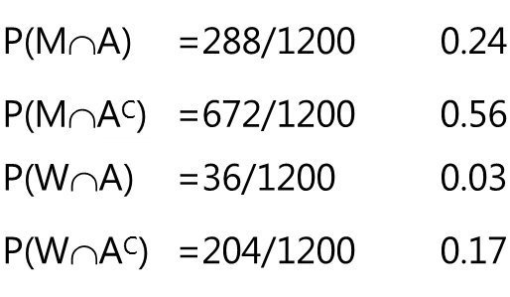
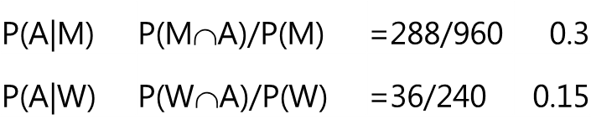
Understanding of Conditional Probability
A women’s group in a college complained that female staff are being discriminated while awarding promotions. The college authorities admitted that more male staff were promoted but this is because men were more in number and there were no undue favors shown to male gender. To verify the claims and counter claims the following data was obtained
30

Slide 31
Baye’s Theorem
Often, to start with we have limited information about an event and its probability. As we acquire additional information, we wish to revise the probability in the light of additional information available.
The initial estimate of probability with which we begin the analysis is called prior probability.
The updated estimate of probability using new information is called posterior probability.
Steps involved in probability revision process:

Slide 32
Baye’s Theorem Application
A firm receives parts from two different suppliers. Currently supplier A1 supplies 65% of requirement and remaining 35% is supplied by supplier A2. 98% of parts supplied by A1 are good and 2% are defective and 95% of parts supplied by A2 are good and 5% are defective.
One of the machines that the firm uses broke down because it processed a bad part. The production manager wants find out who could have supplied the bad part. The question is
What is the probability P(A1|B) that the bad part was supplied by A1
What is the probability P(A2|B) that the bad part was supplied by A2

Slide 33
Probability Tree
G
P(G|A1) =0.98
P(A1∩G) = P(A1)P(G|A1)
0.65X0.98 = 0.6370
A1
P(A1) =0.65
B
P(A1∩B) = P(A1)P(B|A1)
P(B|A1) =0.02
0.65X0.02 = 0.0130
G
P(G|A2) =0.95
P(A2∩G) = P(A2)P(G|A2)
A2
0.35X0.95 = 0.3325
P(A2) =0.35
B
P(A2∩B) = P(A2)P(B|A2)
P(B|A2) =0.05
0.35X0.05 = 0.0175
Supplier
Condition
G=good; B=Bad

Slide 34
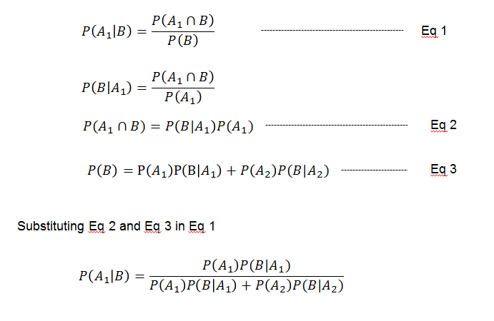
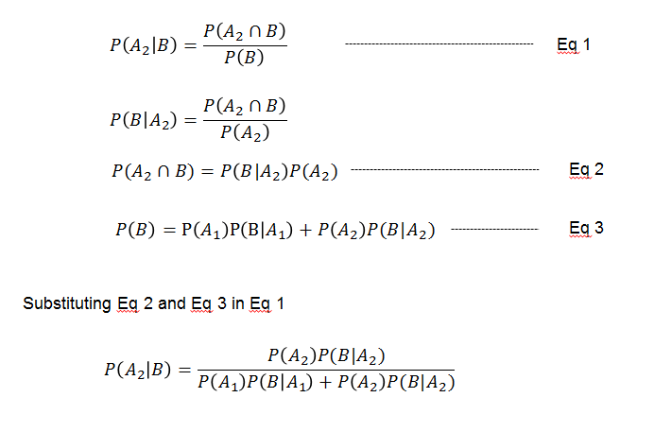
Baye’s Theorem Formula

Slide 35
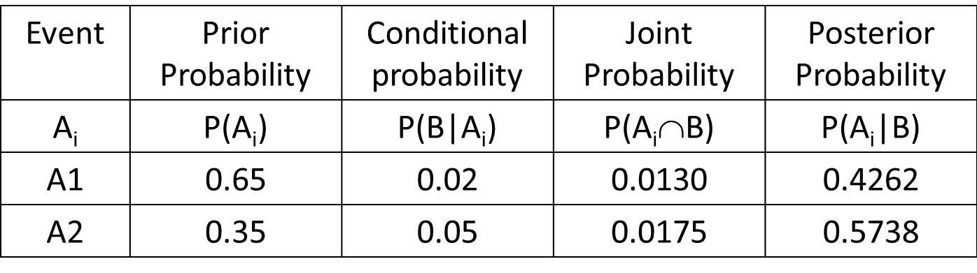
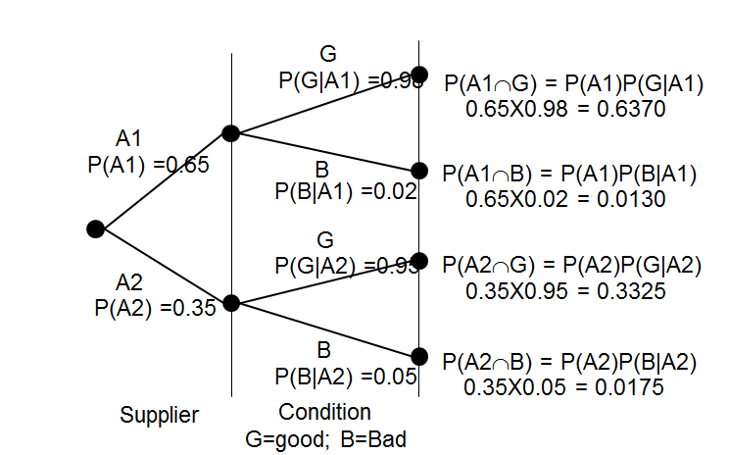
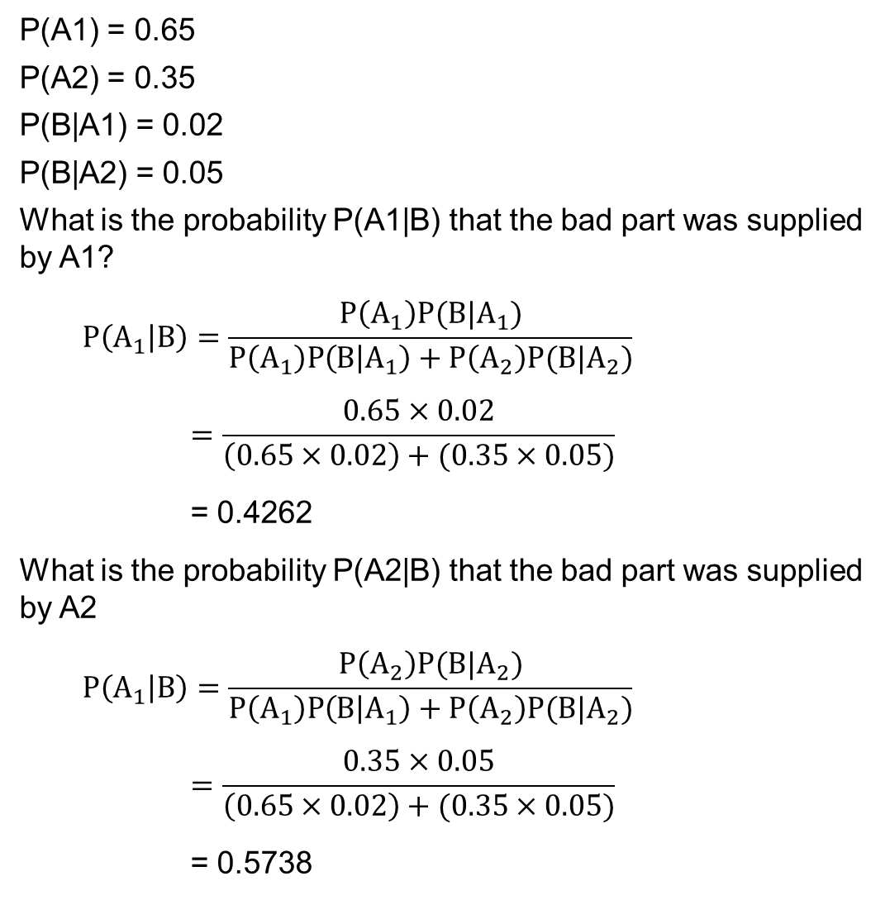
Baye’s Theorem – Solution for supplier problem
P(A1) = 0.65
P(A2) = 0.35
P(B|A1) = 0.02
P(B|A2) = 0.05
What is the probability P(A1|B) that the bad part was supplied by A1?
$$P\left(A_{1} | B\right)=\frac{P\left(A_{1}\right)P(B|A_{1})}{P\left(A_{1}\right)P\left(B | A_{1}\right)+P\left(A_{2}\right)P(B|A_{2})}$$
$$=\frac{0.65×0.02}{\left(0.65×0.02\right)+(0.35×0.05)}$$
= 0.4262
What is the probability P(A2|B) that the bad part was supplied by A2
$$P\left(A_{1} | B\right)=\frac{P\left(A_{2}\right)P(B|A_{2})}{P\left(A_{1}\right)P\left(B | A_{1}\right)+P\left(A_{2}\right)P(B|A_{2})}$$
$$=\frac{0.35×0.05}{\left(0.65×0.02\right)+(0.35×0.05)}$$
= 0.5738

Slide 36
Thank You

